Slide 1

Classification of Aquatic Animals Using Convolutional
Shreyas BP
01JST17IS045
Department of Information Science and Engineering

Slide 2
Problem Statement
Classification of images into beaver, dolphin, otter, seal, whale, aquarium fish, flatfish, ray, shark, and trout using Convolutional Neural Network.

Slide 3
Introduction
CIFAR-100 dataset (Canadian Institute for Advanced Research) is a collection of images that are commonly used to train machine learning and computer vision algorithms. This dataset consists of 100 classes out of which I extract 10 classes.
10 classes we chose are 'aquarium fish', 'beaver', 'dolphin', 'flatfish', 'otter', 'seal', 'whale', 'ray', 'shark', and 'trout‘.
https://www.cs.toronto.edu/~kriz/cifar.html

Slide 4
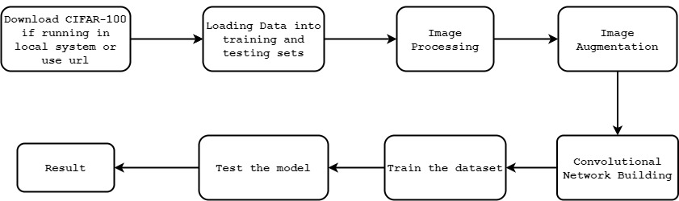
Block Diagram
Simplified block diagram

Slide 5
Challenges
Input size: I have only 6000 images, out of which 1000 are for testing. Left images for training are only 5000. This may be not enough to train the ConvNet.
Hardware resource: Since CIFAR-100 has 60000 images loading it on small RAM pc is not possible.
All these 10 classes are closely related, so classifying in challenging.

Slide 6
Motivation
Since I have chosen the first 10 classes which belong to 2 super classes i.e. Aquatic mammals and Fishes. Most of these images have same background.
All these 10 classes are closely related, so classifying in challenging.
During the process I learn about the way computer recognizes the image and how it process it.
Get an opportunity to learn the basics of Convolutional Neural Network

Slide 7
Objectives
The main objective of this project is to understand computer vision course and applying the learned method to classify Aquatic Animals into Aquatic Mammals and Fishes as Superclass and further Aquatic mammals into beaver, dolphin, otter, seal, whale, and Fishes into aquarium fish, flatfish, ray, shark, and trout.
Understanding the working of ConvNet.

Slide 8
LITERATURE SURVEY

Slide 9
Sr. No. | Author | Year | Paper Name | Conclusion
1 | Y. LeCun, B. Boser, J. S. Denker, D. Henderson, R. E. Howard, W. Hubbard, L. D. Jackel | 1989 | Backpropagation Applied to Handwritten Zip Code Recognition. Neural Computation | About backpropagation and how it is important to CNN.
2 | Daniel Svozil, Vladimir KvasniEka, Jiri Pospichal | 6th June 1997 | Introduction to multi-layer feed-forward neural networks | About Forward propagation and how it is important to CNN.
3 | Dan C. Cires¸an, Ueli Meier, Jonathan Masci, Luca M. Gambardella, Jurgen Schmidhuber | 2011 | Flexible, High Performance Convolutional Neural Networks for Image Classification | Basic Knowledge on CNN and how it working.
4 | Andrew G. Howard | 2013 | Some Improvements on Deep Convolutional Neural Network Based Image Classification | How to improve CNN for better Accuracy.
5 | Kaiming He, Jian Sun | 2015 | Convolutional Neural Networks at Constrained Time Cost | How time constraints effects the CNN model. And how to get time complexity of a model.
6 | Antonio Gulli, Sujit Pal | April 2017 | Deep Learning with Keras | Everything that we need to know about Keras.

Slide 10
Algorithm
Step 1: Input Image 64 x 64 x 3
Step 2: Extraction of required classes and split them into train and test.
Step 3: Feeding the training dataset is fed into the build model.
Step 4: Test the model using the test dataset.
Step 5: Plot graphs of accuracy and loss.

Slide 11
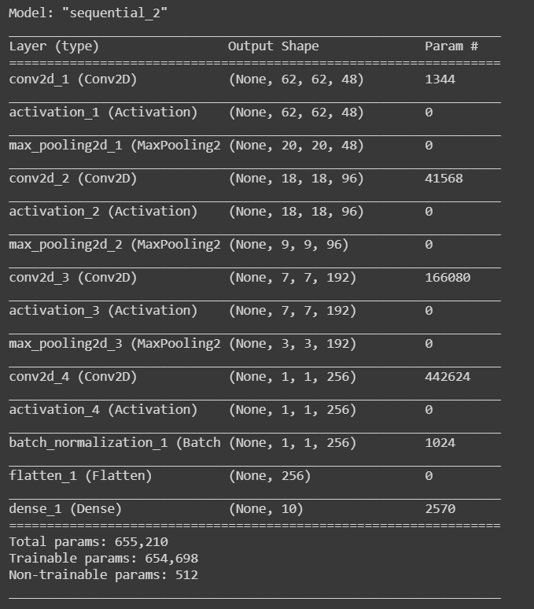
Model Summary

Slide 12
Results
Batch Size | Number of epochs | Test Accuracy | Average train Accuracy
32 | 50 | 52.1% | 56%
32 | 100 | 47.1% | 58%
64 | 50 | 45.6% | 42.5%
64 | 100 | 49.5% | 50.7%

Slide 13
Discussion on Results
model overfitted the data since the training set constantly eliminates loss while the test set is nearly constant after the 20-30th epoch and even getting higher.
was able to get near 70-80 & for the CIFAR-10 but not for our dataset. The reason was, the dataset size, we had 5000 images for training and out of that 1000 for training
We also noticed that the initial accuracy after the first training epoch is significantly higher for model with Batch Normalization versus without Batch Normalization.

Slide 14
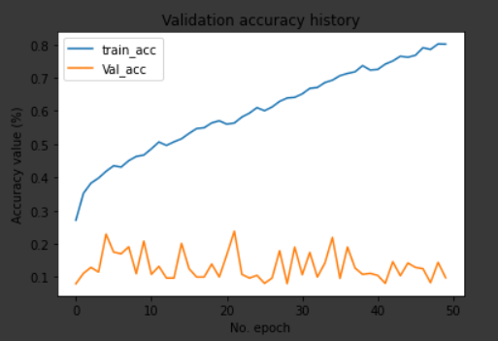
Another thing that I noticed what that when we used Adam() optimizer, the training accuracy of the model was very good but the validation accuracy was too and was constant. Hence, I chose RMSprop.

Slide 15

The Complexity of the Algorithm
The computational complexity of a feed-forward neural network, and seen why it's attractive to split the computation up in the training and an inference phase since backpropagation, $O(n^{5})$ is much slower than the forward propagation, $O(n^{4})$.

Slide 16
CONCLUSION AND FUTURE SCOPE
The main aim was to understand the basics of Computer Vision concepts and Convolutional Neural Network. Our ConvNet was able to achieve around 50-55% maximum accuracy due to various constraints. The model could be increased to achieve better accuracy. But in the end, the same concept is to be used.
The future scope is that with more hardware resources and dataset availability we can achieve higher accuracy.

Slide 17
THE END

